Slide 1

Oblique Flankplasty as an Alternative to Lower Body Lift
Dennis J. Hurwitz, M.D., FACS
Director of the Hurwitz Center for Plastic Surgery
Clinical Professor Of Plastic Surgery

Slide 2
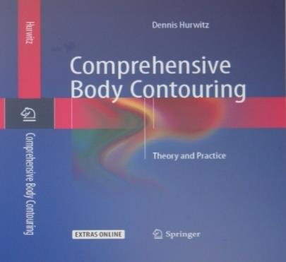
Disclosure
Comprehensive Body Contouring
Direct Flank excision pp. 68-72
Paid instructor for InMode
2 lectures 2015-2016. $2,000
Investigated RFAL BodyTite in 2012-14
All expense paid for 20 patients

Slide 3
Objectives:
Appreciate Flank Aesthetics, Deformity, Waist/Hip ratio
Pitt Grade Flank Deformity/Results
Aesthetic Score lower posterior torso
Learn range of body contouring of Flanks/Waist
Minimally Invasive…VASERlipo and BodyTite
Circumferential Lower Body Lifts (LBL, belt lipectomy)
Oblique Flankplasty with Lipoabdominoplasty (OFLA)
Learn Oblique Flankplasty technique
Know Indications, Limitations, Complications
How to avoid FDL abdominoplasty
Apply Flankplasty to secondary deformity
Prefer Flankplasty over LBL or FDL abdominoplasty

Slide 4
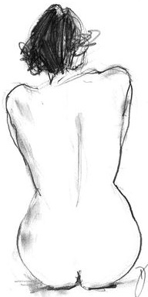
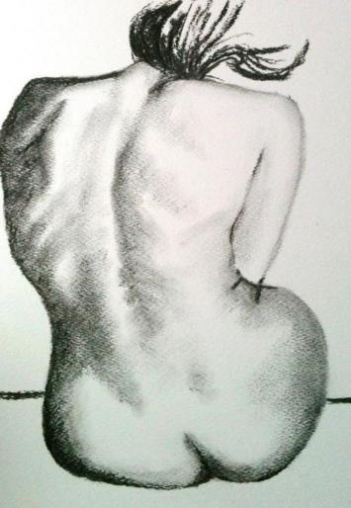
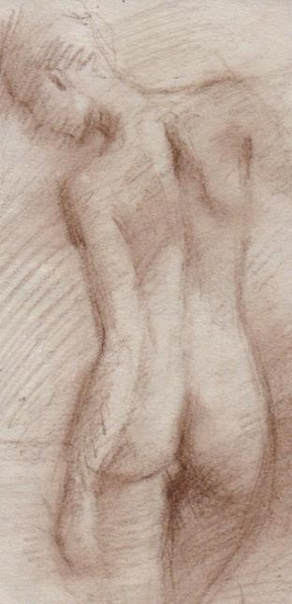
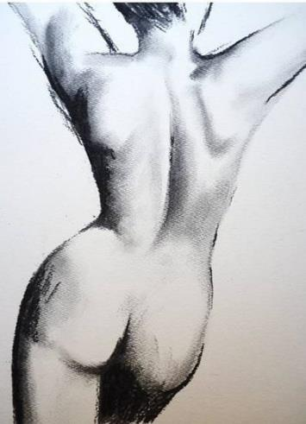

Slide 5
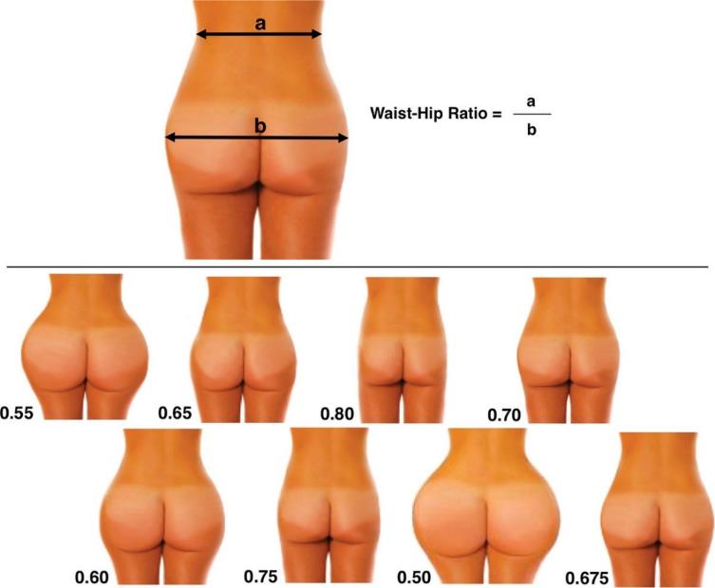
Redefining Ideal Buttocks: A Population Analysis*
Ideal buttocks as related to waist guides surgery
Digitally altered buttocks to vary waist to hip ratios
1146 responses
Most attractive .65
Next .60
*Wong WM, Motakef S, Lin TS, Gupta SC, Redefining the Ideal Buttocks: A Population Analysis, Plast Reconstr Surg. 2016;137, 1739-1747.

Slide 6
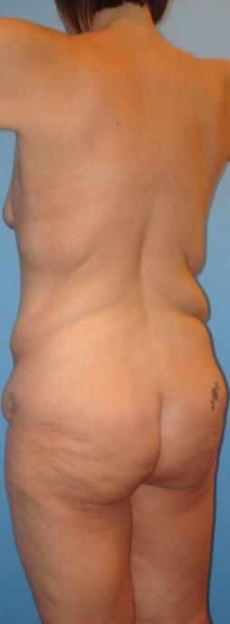
New Approach to Posterior Torso
Accept Patient’s Desire, Body Shape
Deformity grade influences treatment
Adherences along midline and flanks
Avoid crossing midline
J Torsoplasty to avoid Bra line excision
Oblique flankplasty to avoid sacrum
Direct excision along adherences best treats
Skin laxity, rolls
Adherences
Maximal tightening of neighboring skin
Excision Site Donor: Enlarge buttock and breast
Sculpture by adipose removal and retention

Slide 7
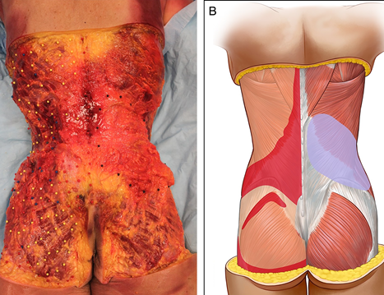

D. Alastair Taylor, Zones of Adhesions of the Abdomen: Implications for Abdominoplasty, Aesth. Surg. J. 2017, 37.37(2) 190-199.

Slide 8
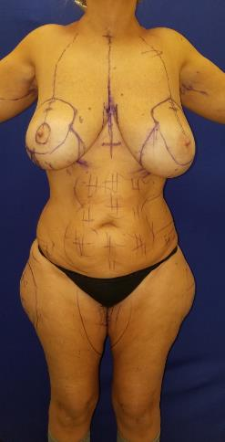
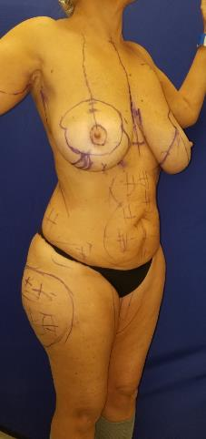
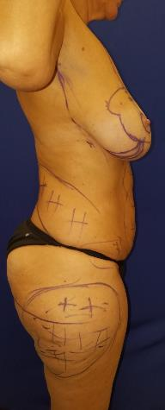
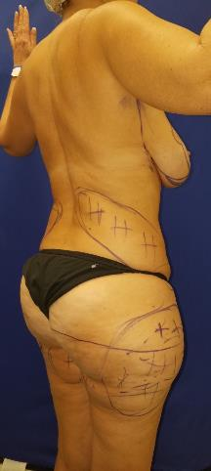
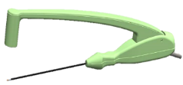
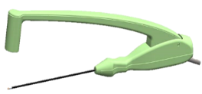
56 y.o.: Breast Reduction, VASERlipo BodyTite: Abdomen, Medial, Lateral thighs

Slide 9
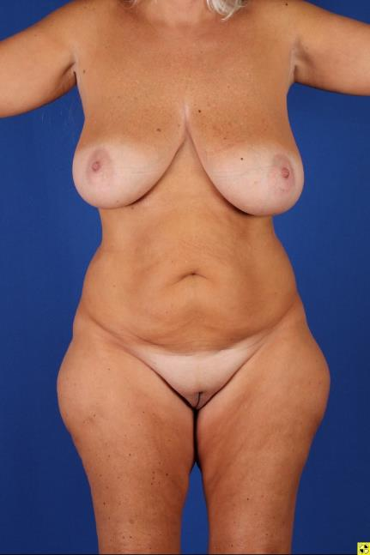
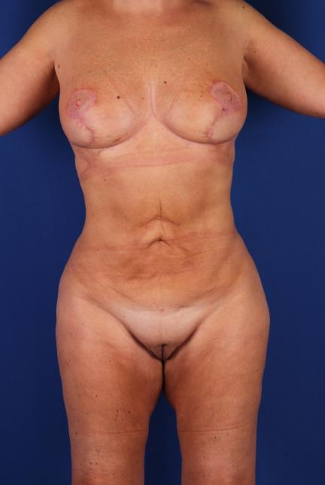
11/2018 4/2019

Slide 10
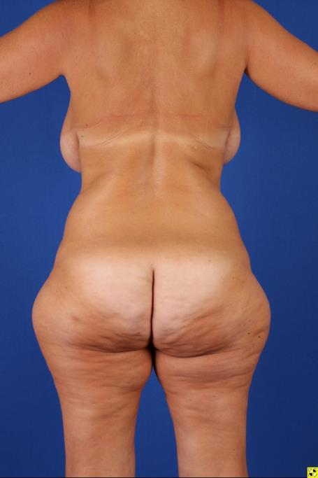
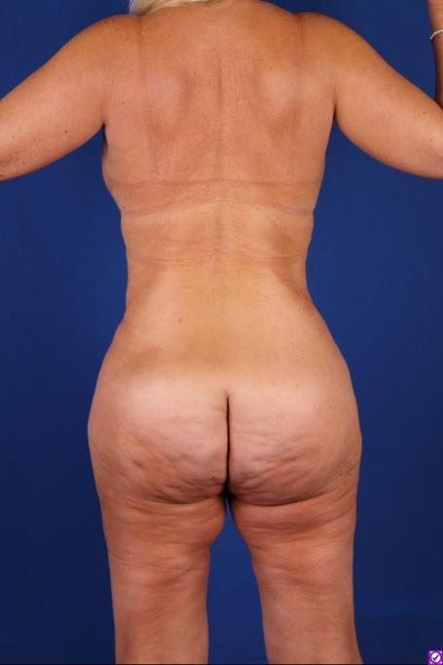

Slide 11
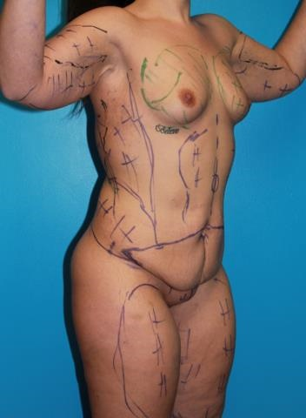
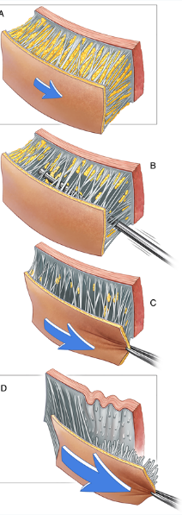
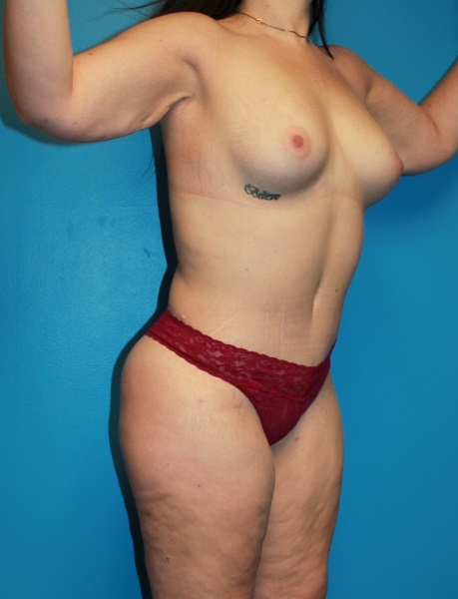
VASER Lipoabdominoplasty/Breast Lipoaug
27 y.o.
125# loss

Slide 12
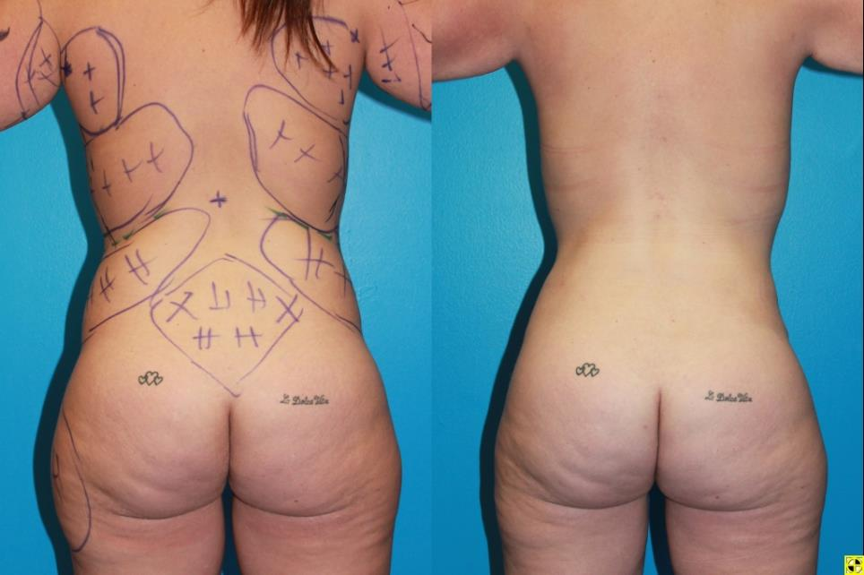
218 .85 Grade 2--0 .66

Slide 13


Prior abdominoplasty/ Failed Lower Body Lift: VASERlipo, Lipoaugmentation of Buttocks

Slide 14
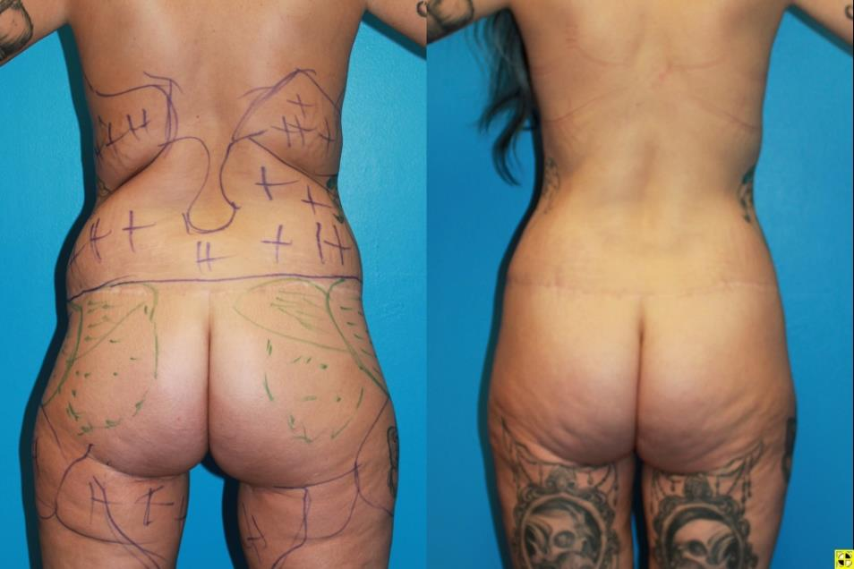
170 VASERlipo .93 Flank Grade 2--0 .72
170

Slide 15
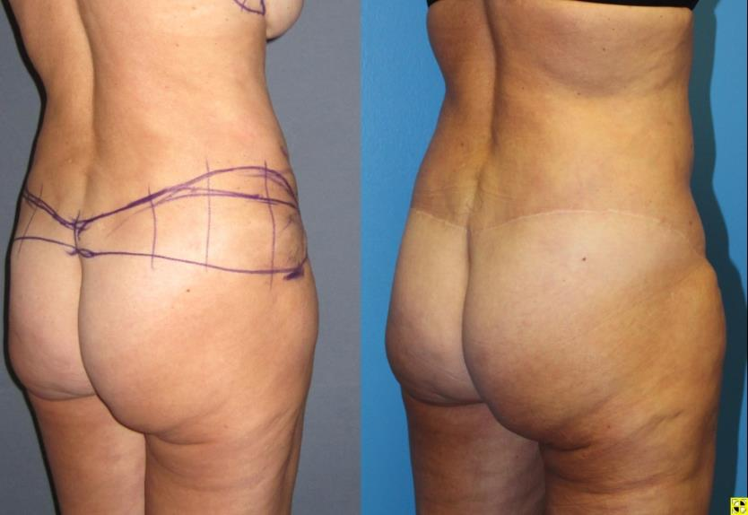
Cosmetic Lower Body Lift
Gonzalez-Ulloa M. Belt lipectomy. Br J Plast Surg, 1960 13:179.
Vilain R, Dubousset J Technics and indications on circular lipectomy. Ann Chir, 1964 18:289.
Lockwood T, Transverse Flank-thigh Buttock Lift with Superficial Fascial Suspension PRS. 1991. 87:6,1019-1027
4/2016 3/2018

Slide 16
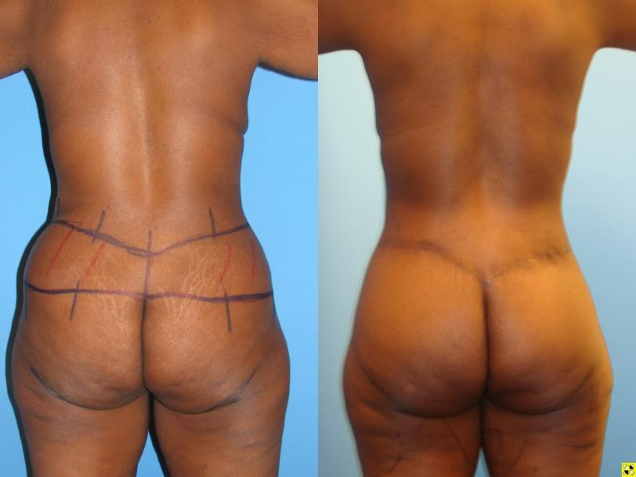
Lower Body Lift after Massive Weight Loss
195 LBL, spiral thighplasty .74 Grade 1--0 .71

Slide 17
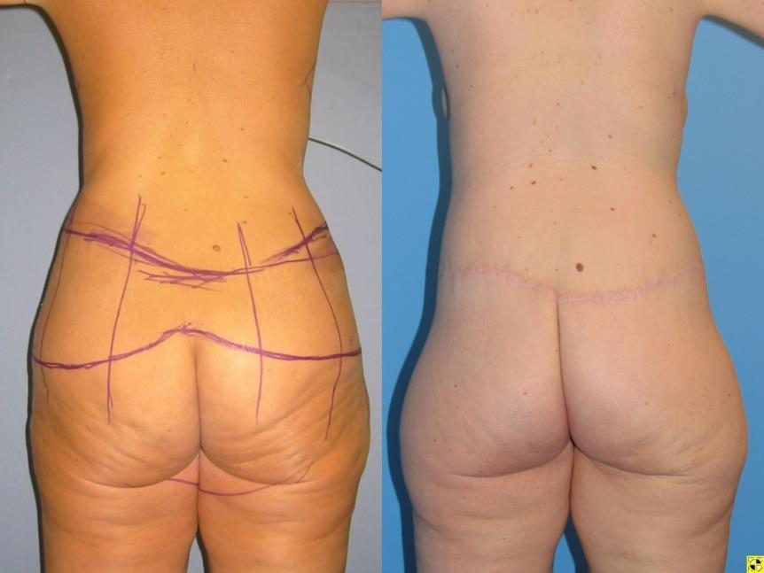
211 Lower Body Lift .78 Grade 1--1 .79

Slide 18
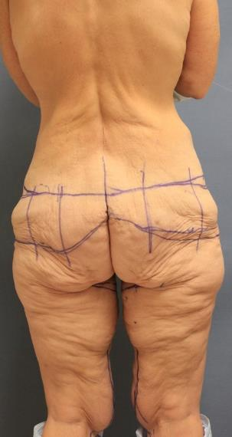
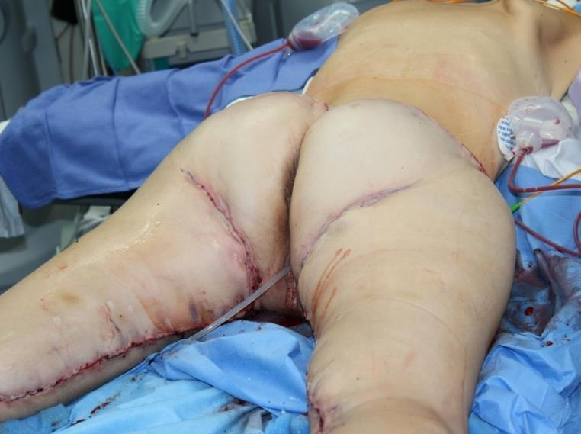
Correcting the Saddlebag Deformity in the Massive Weight Loss Patient
Hurwitz D, Rubin JP, Risin M, Sajjadian A, Sereika, Plast Recon Surg. 2004:114:5,1313.

Slide 19
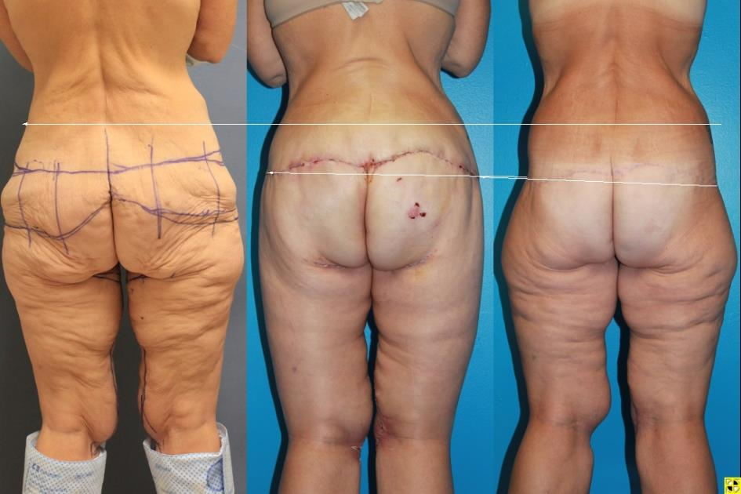
Inferior Drift of Scar, Saddlebags, Lateral gluteal Depressions, Elongated Gluteal Cleft
2 weeks 6 months

Slide 20
Pascal JF, LeLouarn C, Remodeling Bodylift with High Lateral Tension. Aesth. Plast Surg. 2002. 267.223-230
Flank Deformity 2 Flank Grade 2

Slide 21
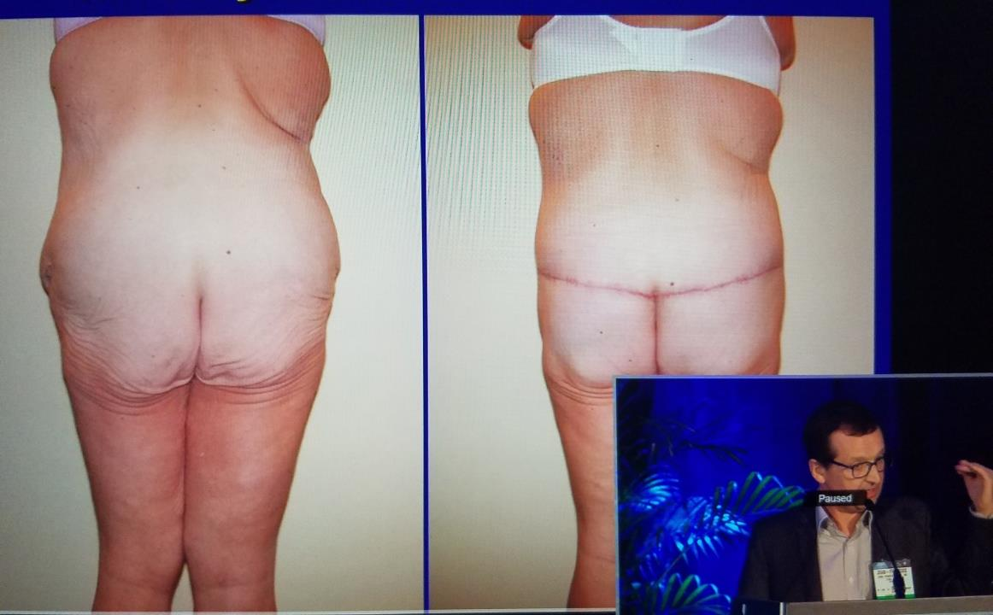
Jean François Pascal Course on Buttock Lifting
ASPS Meeting October, 2017

Slide 22
Circumferential Contouring of the Lower Trunk: Indications, Operative Techniques, and Outcomes—A Systematic Review*
PRISMA Criteria: 42 articles and 1748 operations
Belt lipectomy: posterior scar at the waistline and better correction of hip, back rolls.
LBL more effective on buttock and lateral thigh ptosis.
Wound dehiscence
Median complication: 37 % (27-46%)
High patient satisfaction
Benefit is mainly functional, not esthetic
No guidelines for indications and contraindications
Better Quality studies
Skin patterns of belt lipectomy (red markings) and lower body lift (blue markings).
*Carloni R, De Runz, S, Chaput B, Herlin C, Girard P, Watier E, Bertheuil N, Aesth Plast Surg (2016) 40:652–668

Slide 23
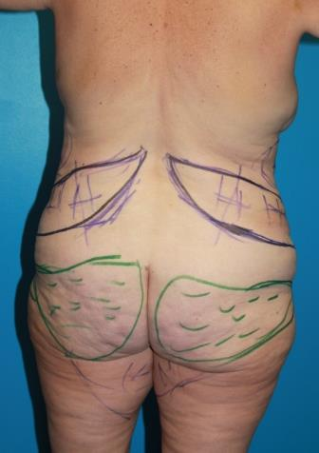
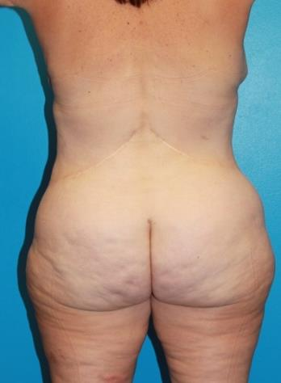
Oblique Flankplasty .
Oblique excision between Costal Margin and Iliac Crest
Variable Adipose Retention along Iliac crests
Muscular Fascia
#2 Barb Suture
Superficial SFS
2-0 Barb Suture
Rotate Buttocks
Narrow Waist
Transition
Buttock Lipofil

Slide 24
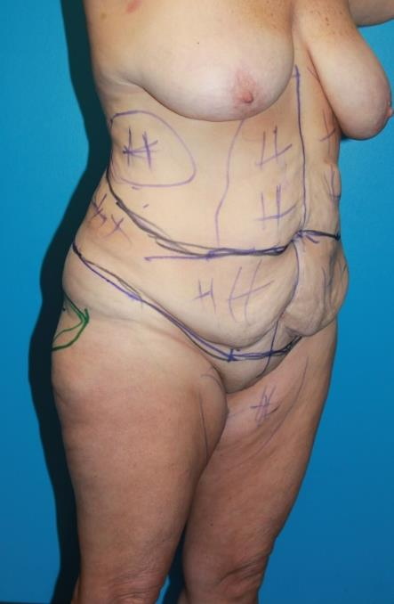
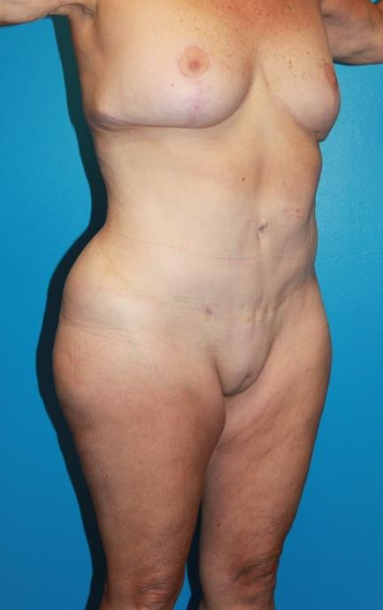

Slide 25
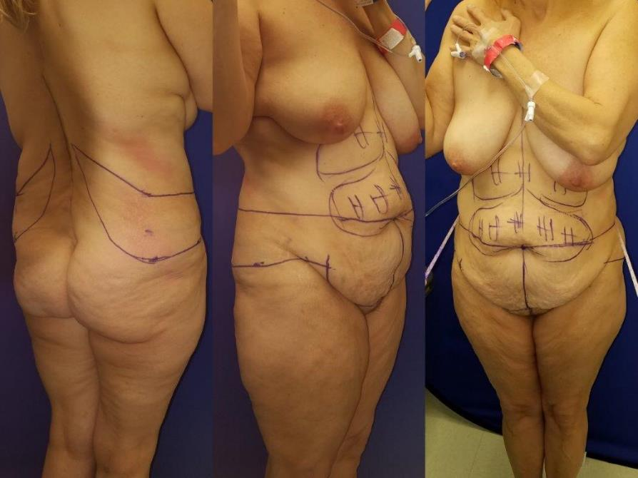
OFLA

Slide 26
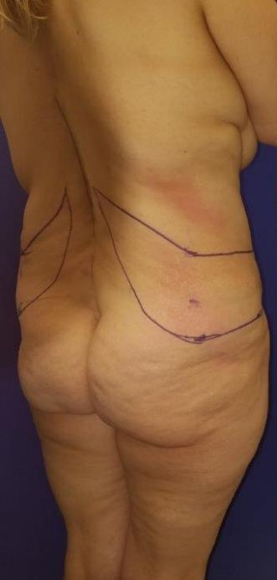
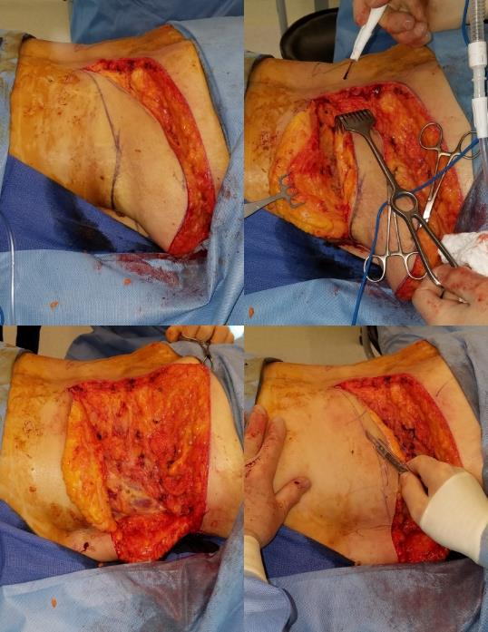

Slide 27
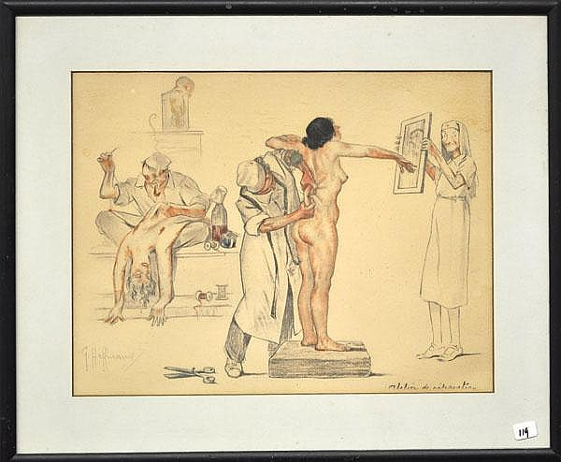
Gustave Hoffman

Slide 28
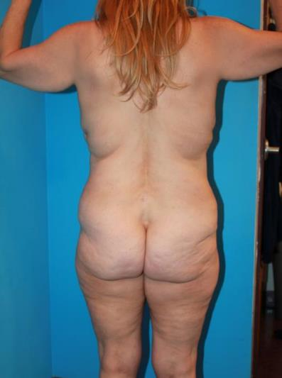
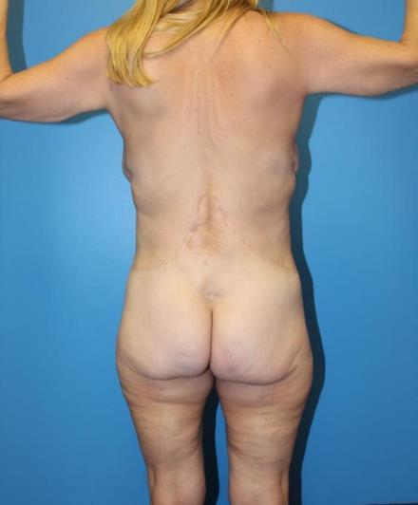
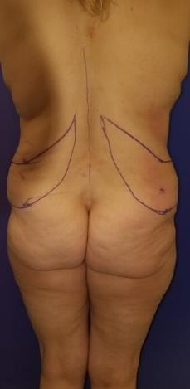
Oblique Flankplasty
.99 Grade 3--0 .83
1/2017 10/2018

Slide 29
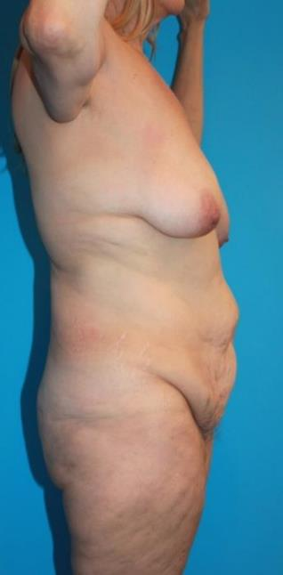
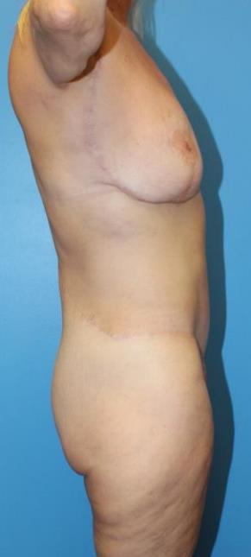
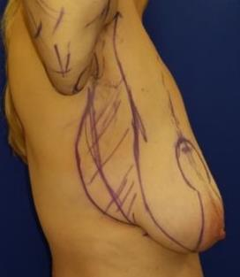
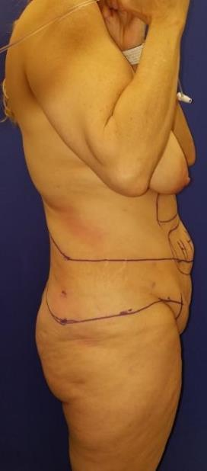

Slide 30
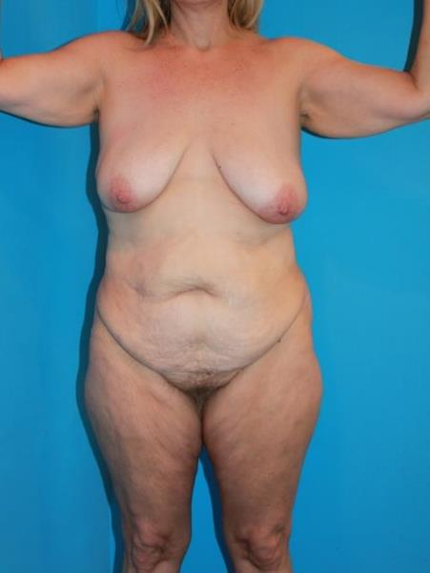
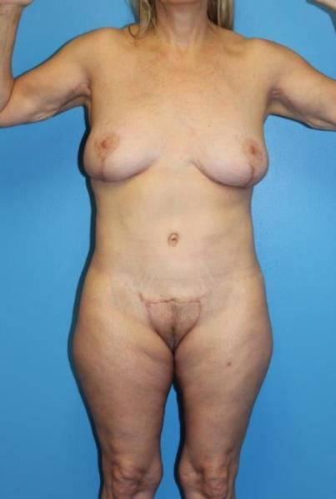
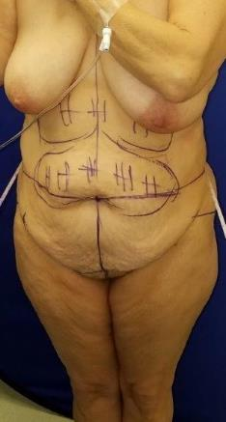
Notes:
Her more recent thigh and monsplasty completes the transformation of a sensually shaped anterior torso with no midline scar.

Slide 31
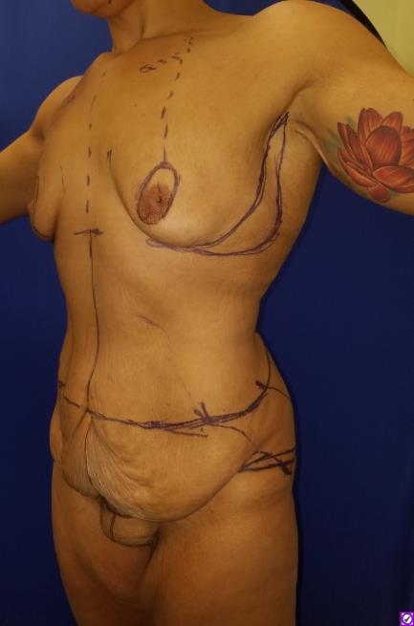
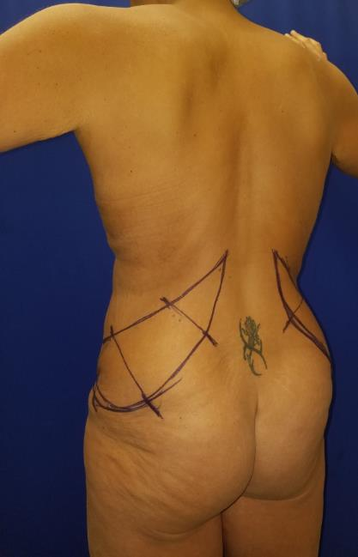

12/2018

Slide 32


12/2018 4/2019

Slide 33


12/2018 4/2019

Slide 34


Oblique flankplasty
Abdominoplasty
Lower body lift
1/2018 BMI 32 10/2005 BMI 31
Notes:
Proof 1 is comparison of the videoed patient to an other, similar by age, weight loss, and BMI who instead underwent circumferential lower body lift.

Slide 35

L Brachioplasty
Mastopexy
Lipoaugmentation
Upper body lift
VASERlipo
Upper thighplasty
L Brachioplasty
Mastopexy
Lipoaugmentation (1000 cc)
Upper body lift
VASERlipo (4,700 cc)
1/2018 10/2005
Notes:
In addition, The flankplasty had 4,700 cc’s extracted by VASERlipo yielding 1,000 cc.’s for lipoaugmentation of her breast and buttocks. The Lower body Lift patient had Wise pattern mastopexy with spiral flap breast reshaping, Brachioplasty and limited thighplasty

Slide 36


5 month result 1 year result
Notes:
Oblique flankplasty combined with lipoabdominoplasty leaves desirable mid torso contours with tightly tapered transition across the hips to the back. None of those aesthetic features are present after circumferential lower body lift.

Slide 37




5 month result 1 year result
Notes:
Compare flankplasty patient with a narrowed waist that elegantly bridges augmented breasts and buttocks to the lower body lift patient with an oversized waist, flat tight-skinned buttocks, but nicely shaped breasts.

Slide 38


1/2018 10/2005
Notes:
Flank excisions will deepen the waist, elevate the lateral buttocks and tighten the entire back as VASERlipo removes excess fat, which provides adipose for her lateral buttocks. On your right, upper and lower body resections are planned to remove loose skin and lift the buttocks.

Slide 39


5 months 1 year
Notes:
Direct flank excisions and VASERlipo succeed in smoothly narrowing the waist and sculpturing the posterior torso in sharp contrast to the body lifts which leave bulging flanks, flattened hips, unsightly scars and saddlebags. She is satisfied because she likes her tight skin and attractive breasts and never expected a nice figure.

Slide 40


.80
.63
5 months
Notes:
The flankplasty patient obtains a smoothly narrowed waist that drops to well-defined hips tapering to curved lateral buttocks, widest above the infragluteal fold… Her unfavorable .80 waist to hip ratio is change to a most desirable .63

Slide 41


5 months

Slide 42


Clinical Observations in 76 pts
Extends, improves Lipoabdominoplasty
Vertical/horizontal waist excess
Smoothly, narrowed waist
Predicable
Removes lateral buttock, thigh excess
Rounded lateral Buttock Lift
Intergluteal cleft unchanged
Para sacral dimples
Closure not over boney sacrum
Modified lower body lift
Donor site for lipoaugmentation
Bulging hip reduced
Smaller rounded hip
Anchored closure
No lateral gluteal depression
No saddlebags
Liposuction low back
Faint scars
Modified for Saddlebags
Easily planned and executed
Two-team
22. No transfusions
23. Outpatient
24. Less pain
25. Reduces epigastric excess
26. Restores musculofascial contours
27. Alternative to FDL abdominoplasty
28. 9% complications
29. Minimal secondary deformity
30. Compliments J Torsoplasty
31. Revises prior LBL/liposuction
Notes:
Proof 2 is 31 favorable observation with some totally unforeseen. Such as… oblique removal of tissue reduces both vertical and horizontal excess… A rounded lateral buttock lift… Correcting saddlebag deformity by lowering the excision pattern… An alternative to Fleur de Lys abdominoplasty.

Slide 43





Null hypothesis: Flankplasty results in greater reduction of flank deformity, and improved aesthetics
0 Normal
1 Adiposity
2 Defined roll
3 Ptotic or Large roll
Pittsburgh Flank Deformity: 0, 1, 2, 3
Pittsburgh Flank Result: 0, 1, 2, 3
1-5 Aesthetics: Back, flanks, Hips/lateral thighs, Buttocks
Notes:
Proof 3 is the grading of results by 18 plastic surgery residents taking a SurveyMonkey pictorial exam of 80 of my cases of lower body lift mixed in, with at that time, all 30 oblique Flankplasties. They applied Pittsburgh flank grading 0 through 3 to both deformity and result, as well as a novel scoring one through five of overall aesthetics.

Slide 44

107 Lower Body Lift .76 .78
Deformity Grade 2 Result Grade 2
1 Worse
2 Same
4 Nice
5 Best
3 better
1 Worse
2 Same
4 Nice
5 Best
3 better
Notes:
One of hundreds before and after images judged by the residents. The operation was listed along with waist to hip ratios… I score her flank deformity 2, and flank result again 2. I reduce posterior torso aesthetics to One due to elevated gluteal cleft, asymmetrical flat hips and new saddlebag deformity.

Slide 45

140 Flankplasty, Lipoabdominoplasty .91 .83
Deformity Grade 2 Result Grade 0
1 Worse
2 Same
4 Nice
5 Best
3 better
1 Worse
2 Same
4 Nice
5 Best
3 better
Notes:
This comparable oblique flankplasty with lipoabdominoplasty case.. of a 2 flank deformity was reduced to zero and her aesthetic result at a best 5.

Slide 46
*18 residents took the survey for
1700 observations of images
A paired t-test compares observer-graded changes
in flank deformity and overall aesthetics.
Group LBL (80) Flankplasty (30) p value
Deformity Score 1.90 2.03 < 0.001
Result Score 1.04 0.71 < 0.001
Aesthetic Score 3.33 4.03 < 0.001
*Hurwitz DJ, Beidas O, Wright L. Oblique flankplasty with Lipoabdominoplasty (OFLA): an alternative to Circumferential Lower Body Lift, Plast Reconstr Surg, May, 2019
Notes:
Pitt body contouring fellow Omar Beidas analyzed the resident unbiased grading.... the Flankplasty cohort had worse flank deformity but far better flank results than Lower body lift patients. The residents also graded overall aesthetics better after flankplasty,
Thus we have independent confirmation of my clinical observations.

Slide 47



J F Pascal, Buttock Lift, ASPS Meeting, October 2017
Notes:
Proof 4. Experts teaching lower body lift surgery suffer from the same problems. 7 months ago, Jean Francois Pascal described tight-skinned buttock lift through precise skin excisions, but failed to point out elongation of the gluteal cleft, depressed lateral buttocks and flattened hips. Ignoring her bulging flanks, he fashions her a rectangular torso .… Compare to my similar patient who was morphed into an hour glass figure with rounded lateral buttocks and suffered none of the secondary deformities that bedevil lower body lift.

Slide 48




Small, Taut and Sculptured Torso
Notes:
These additional views complete a 360 degree appreciation of her sculpture torso with rounded lateral buttocks that smoothly taper into a deep waist… Her preoperative views show bulky and sagging tissues which obscured her femininity. Her recent second stage J torsoplasty upper body lift with breast reshaping reveal the artistic interplay these operations.

Slide 49



8/2017 10/2018

Slide 50

High Belt Lipectomy is not good enough
LBL/buttock flap aug, High belt lipectomy, Oblique flankplasty
Notes:
Proof 5. A high transverse belt lipectomy in males as seen in the middle two images, while an improvement over lower body lift seen on your left, fails in comparison to oblique flankplasty, seen in a comparable patient on the right. Not only does oblique flankplasty obliterate bulging flanks and loose gluteal skin, but doesn’t leave annoying lateral gluteal depressions. Desirable upper body dominance is a by-product broadly narrowed waist and lateral buttocks separate by minimally defined hips.

Slide 51
Complications in 44 cases
Oblique flankplasty/lipoabdominoplasty
9% minor wound healing
2 seromas responded to aspiration
2 limited delayed wound healing
No infections, transfusions, DVT’s, PE’s
Secondary liposuction, RFAL skin tightening
No revisions
LBL, Belt Lipectomy: 37 % (27-46%)
Circumferential Contouring of the Lower Trunk: Indications, Operative Techniques, and Outcomes—A Systematic Review. Carloni R, De Runz, S, Chaput B, Herlin C, Girard P, Watier E, Bertheuil N, Aesth Plast Surg (2016) 40:652–668
Notes:
Proof 6. Patient morbidity and complications are low at 9% and self limiting. A recent meta analysis by Carlino’s group places the median complication rate of lower body lift at 37%, but up to nearly 50%.

Slide 52



Oblique Flankplasty: Better than lower Body lift!
Thank you
Notes:
These six proofs substantiate that in properly selected patients, oblique flankplasty with Lipoabdominoplasty provides outcomes superior to circumference lower body lift. A single case video presents logical planning and execution of rather simple and low morbidity outpatient body lift surgery.

Slide 53



Oblique Flankplasty: Abdomen Grade 3c*
*Double roll extending to the back
Zammerilla LL et al., Classifying Severity of Abdominal Contour Deformities after Weight Loss : A Review of 1006 Cases, Plast Reconstr Surg, 2014, 134:6, 888e-894e.

Slide 54




Slide 55





Slide 56




Slide 57


*Pittsburgh 3b: Fleur de lys Abdominoplasty
*Zammerilla LL, Zou RH, Dong ZM, Winger DG, Rubin JP, Gusenoff JA, Classifying Severity of Abdominal Contour Deformities after Weight Loss PRS, 2014, 134:6, 888e-894e.
Notes:
As a guide to using inverted T abdominoplasty to remove transverse excess I consider the 2014 revised Pittsburgh grading scale which places this patient with a hemicircumferetial ring of loose skin a 3b with 3d being the worst at 3 cirmcumfential rings. Her supra pubic scar contraction is due to all-too-common skin necrosis. Both the long vertical midline scar and absent musculoskeletal contours are recognized aesthetic drawbacks. As usual, the waist is minimally narrowed.

Slide 58


FDL: Abdominoplasty,
L Brachioplasty, Lower Body Lift, VASERlipo thighs
Notes:
Her lower body lift reduces skin laxity and lifts the buttocks, leaving a rectangular figure with no change in the flanks.

Slide 59



5/2018

Slide 60


4216 gm
1024 gm
828 gm
Lost 100#
BMI: 37.2
5/4/2018
1800 aspirate

Slide 61




2 months

Slide 62



BMI 31, HCG/500 cal, lost 15 pounds
3 months, 43

Slide 63


7/11/2018

Slide 64



4 months

Slide 65



57 y.o. GBS 372-177#, Abdomen 3c*
*Change in body mass index correlated with deformity grade

Slide 66


12/2017 3/2018

Slide 67



12/2017 3/2018

Slide 68

Saddlebag Deformity
3/29/2018

Slide 69





OF revision of Cosmetic LBL
7/2016 9/2018 4/2019

Slide 70


Abdominoplasty Succeeds in Males
4/2004 4/2007

Slide 71


Lower Body Lift with UAL of Flanks Fails
3 years

Slide 72


Slide 73


HCG Diet, Single Stage Total Body Lift

Slide 74



Grade 3--0
Two Years

Slide 75


12/ 2016 9/26/2017

Slide 76


12/2/2016

Slide 77



10/2017

Slide 78


Slide 79

4/2/2018

Slide 80


2 stages,
2 years

Slide 81



120# weight loss Massive resection
Lipoabdominoplasty
Right Inquinal Mesh herniaorrhaphy
Oblique Flankplasty
Frame Monsplasty
Limited Thighplasty
7/2017

Slide 82


Slide 83



Slide 84



Oblique Flankplasty for Secondary Surgery
3/31/2017

Slide 85



18 months

Slide 86



18 months

Slide 87

18 months

Slide 88


Lipoabdominoplasty, Oblique Flankplasty, BodyTite x2 Gynecomastia
11/2017 7/2018 4/2019

Slide 89


11/2017 4/2019

Slide 90



OF Revision of LBL
1/23/2018

Slide 91


Oblique Flankplasty Data
14 Male Cases
Pittsburgh Class 2 and 3 flanks
Eliminates flank bulge
Natural silhouette
3 cm dehiscence, seroma aspirated
64 Female Cases
Pittsburgh Class 2 and 3 flanks
Deep transitioned waist
Corrects saddlebags
5 cm dehiscence (23), 2 seroma aspirated

Slide 92


OF/ Abdominoplasty Indications
Pittsburgh Flank Grade 2, 3
Desires deep flank, narrow waist
Lateral Buttock, Thigh Sag
Abdomen 3 a-d
Boney sacrum
Hip/thigh 0-1
Buttock 0-1
Failed LBL
Failed Liposuction

Slide 93
Objectives:
Appreciate Flank Aesthetics, Deformity, Waist/Hip ratio
Pitt Grade Flank Deformity/Results
Aesthetic Score lower posterior torso
Learn range of body contouring of Flanks/Waist
Minimally Invasive…VASERlipo and BodyTite
Circumferential Lower Body Lifts (LBL, belt lipectomy)
Oblique Flankplasty with Lipoabdominoplasty (OFLA)
Learn Oblique Flankplasty technique
Know Indications, Limitations, Complications
How to avoid FDL abdominoplasty
Apply Flankplasty to secondary deformity
Prefer Flankplasty over LBL or FDL abdominoplasty

Slide 94

Oblique Flankplasty as an alternative to Lower Body Lift
Thank you

